Slide 1
CSC 425 – Final Project
Time Series Analysis on
China Resources Pharmaceuticals (SH.600062)
Objective: Apply time series analysis to assist investment
Zhenyang Lu
Data resource: Tongdaxin Financial Data Center \ Yahoo-Financa (China)

Slide 2
ASSUMPTION ON DATASET
How much data necessary ??
Long-term dataset for long-term investment –
5 years (Year 2008 – Last week!) Presented

Slide 3
FRAMEWORK
Exploratory analysis
Model fitting
Residual diagnostics
Forecast analysis
Application
Drawback

Slide 4
EXPLORATORY
Time plot of stock performance
Time plot of simple return
Serial correlated?
ARCH effect? 1 2
GARCH MODEL!

Slide 5
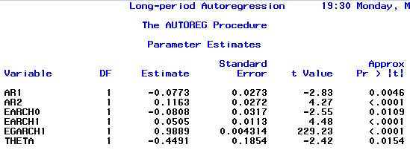
MODEL FITTING
AR(2)-EGARCH(1,1)
EGARCH?
AR(P) ?

Slide 6
REDISUALS DIAGNOSTICS
Standard residual
Acceptable( To be discussed)
Squared standard
residual
Very good!
Normality
Not bad!

Slide 7
FORECAST – 3 STEPS AHEAD 0.58%(predicted) vs -1.44%(actual)
1-STEP
Return=0.28 %
2-STEP
Return=0.3 %
3-STEP
95% confidence [-4.62%,5.18%]
95% confidence [-4.6%,5.2%]
Return=0.0 %
95% confidence [-4.96%,4.94%]
Vs 1.49%
Vs -4.35%
Vs 1.53%

Slide 8
APPLICATION(SHORT-TERM EFFECTIVE)
ExPECTed return
RISK management

Slide 9
DRAWBACK
ACF of standard residual
L-B test on standard residual
Standard residual seasonal?
Possible Solution?
SARIMA-EGARCH?

Slide 10
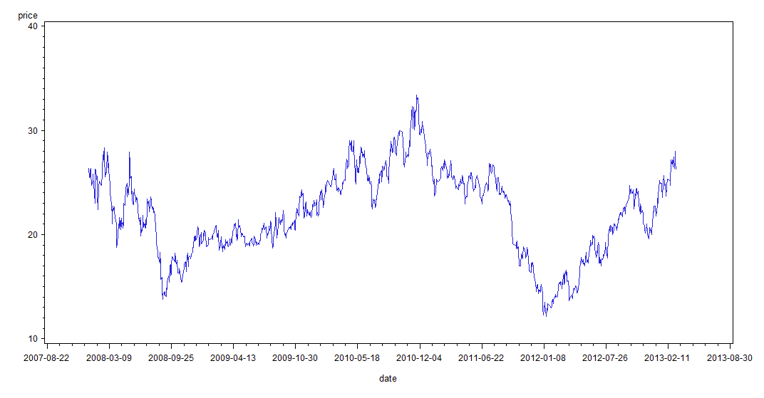

Slide 11
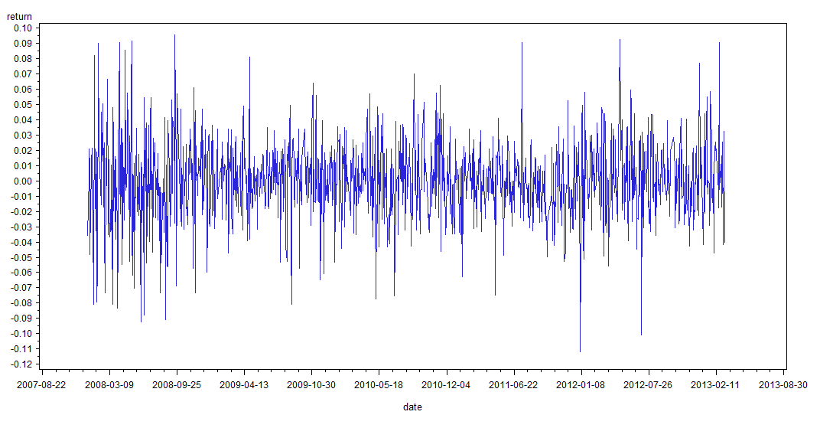

Slide 12
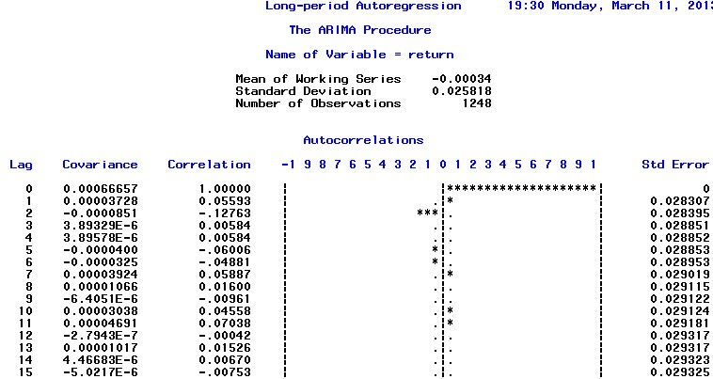

Slide 14
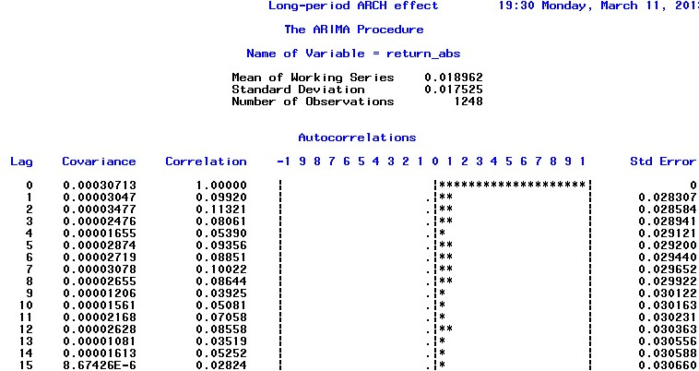

Slide 15
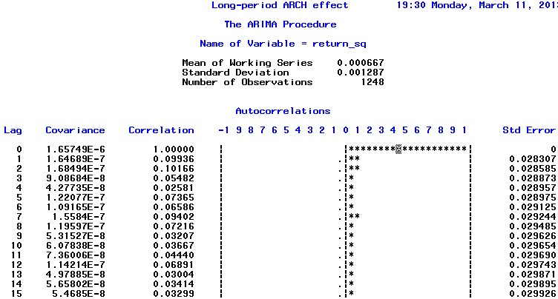

Slide 16
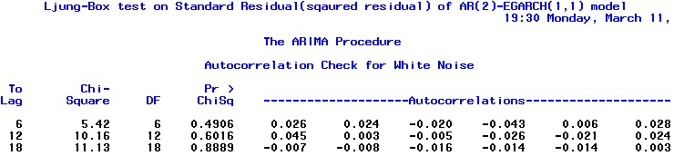

Slide 17
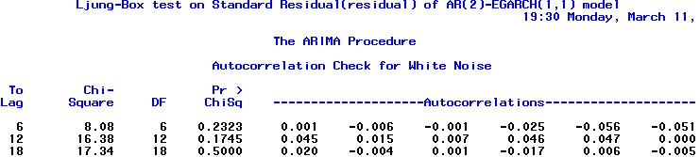

Slide 18
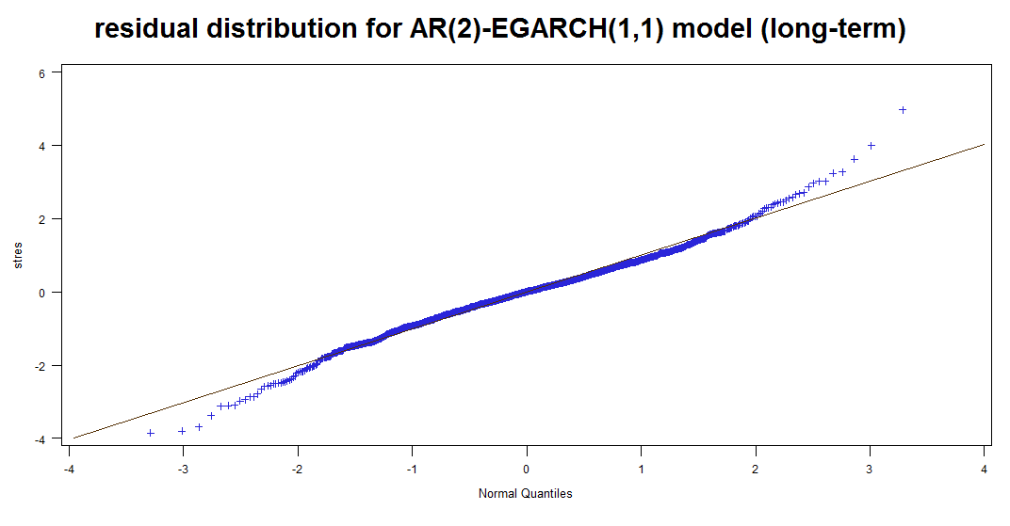

Slide 19
